Slide 1
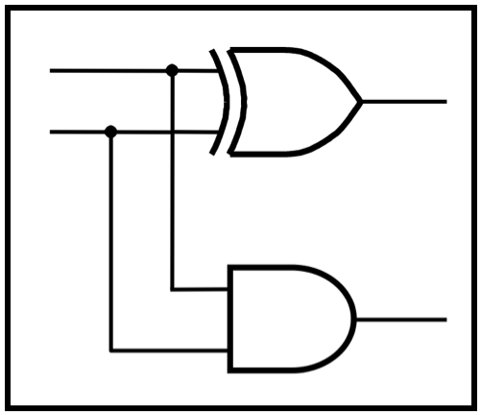
CprE 281:
Digital Logic
Instructor: Alexander Stoytchev
http://www.ece.iastate.edu/~alexs/classes/

Slide 2
Minimization
CprE 281: Digital Logic
Iowa State University, Ames, IA
Copyright © Alexander Stoytchev

Slide 3
Administrative Stuff
HW4 is out
It is due on Monday Sep 19 @ 4 pm
It is posted on the class web page
I also sent you an e-mail with the link.

Slide 4
Example:
K-Map for the 2-1 Multiplexer

Slide 5
2-1 Multiplexer (Definition)
Has two inputs: x₁ and x₂
Also has another input line s
If s=0, then the output is equal to x₁
If s=1, then the output is equal to x₂

Slide 6
Circuit for 2-1 Multiplexer
x
s
1
f
x
1
0
f
s
x
2
1
x
2
(b) Circuit
(c) Graphical symbol
[ Figure 2.33b-c from the textbook ]

Slide 7
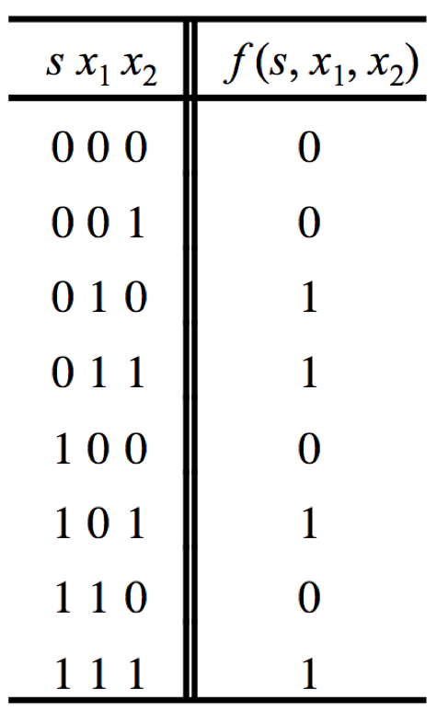
Truth Table for a 2-1 Multiplexer
[ Figure 2.33a from the textbook ]

Slide 8
Let’s Draw the K-map
[ Figure 2.33a from the textbook ]

Slide 9

Let’s Draw the K-map

Slide 10
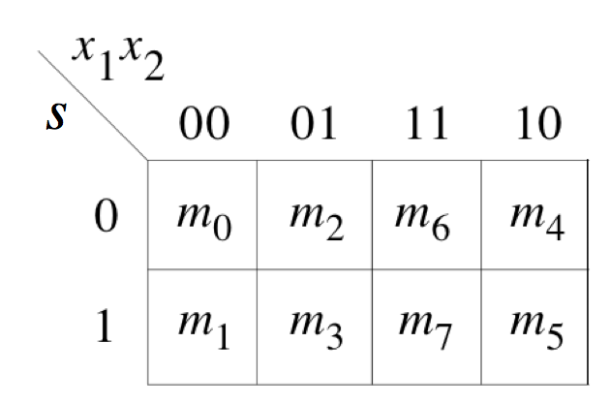
Let’s Draw the K-map

Slide 11
Let’s Draw the K-map
0
1
0
0
0
1
1
1

Slide 12
Let’s Draw the K-map
0
1
0
0
0
1
1
1

Slide 13
Let’s Draw the K-map
0
1
0
0
0
1
1
1
f (s, x_{1,} x₂) =
x₁ x₂
+
s x₁

Slide 14
Let’s Draw the K-map
0
1
0
0
0
1
1
1
f (s, x_{1,} x₂) =
x₁ x₂
+
s x₁
Something is wrong!

Slide 15
Compare this with the SOP derivation

Slide 16
Let’s Derive the SOP form

Slide 17
Let’s Derive the SOP form

Slide 18
Let’s Derive the SOP form
Where should we
put the negation signs?
s x₁ x₂
s x₁ x₂
s x₁ x₂
s x₁ x₂

Slide 19
Let’s Derive the SOP form
s x₁ x₂
s x₁ x₂
s x₁ x₂
s x₁ x₂

Slide 20
Let’s Derive the SOP form
s x₁ x₂
s x₁ x₂
s x₁ x₂
s x₁ x₂
f (s, x_{1,} x₂) =
s x₁ x₂
+
s x₁ x₂
+
s x₁ x₂
+
s x₁ x₂

Slide 21
Let’s simplify this expression
f (s, x_{1,} x₂) =
s x₁ x₂
+
s x₁ x₂
+
s x₁ x₂
+
s x₁ x₂

Slide 22
Let’s simplify this expression
f (s, x_{1,} x₂) =
s x₁ x₂
+
s x₁ x₂
+
s x₁ x₂
+
s x₁ x₂
f (s, x_{1,} x₂) =
s x₁ (x₂ + x₂)
+
+
s (x₁ +x₁ )x₂

Slide 23
Let’s simplify this expression
f (s, x_{1,} x₂) =
s x₁ x₂
+
s x₁ x₂
+
s x₁ x₂
+
s x₁ x₂
f (s, x_{1,} x₂) =
s x₁ (x₂ + x₂)
+
+
s (x₁ +x₁ )x₂
f (s, x_{1,} x₂) =
s x₁
+
s x₂

Slide 24
Let’s Draw the K-map again
[ Figure 2.33a from the textbook ]

Slide 25
Let’s Draw the K-map again

Slide 26
Let’s Draw the K-map again

Slide 27
Let’s Draw the K-map again

Slide 28
Let’s Draw the K-map again
s x₁
x₂
The order of the labeling matters.

Slide 29
Let’s Draw the K-map again
s x₁
x₂

Slide 30
Let’s Draw the K-map again
s x₁
x₂
0
1
0
0
0
1
1
1

Slide 31
Let’s Draw the K-map again
s x₁
x₂
0
1
0
0
0
1
1
1

Slide 32
Let’s Draw the K-map again
s x₁
x₂
0
1
0
0
0
1
1
1
f (s, x_{1,} x₂) =
s x₁
+
s x₂
This is correct!

Slide 33
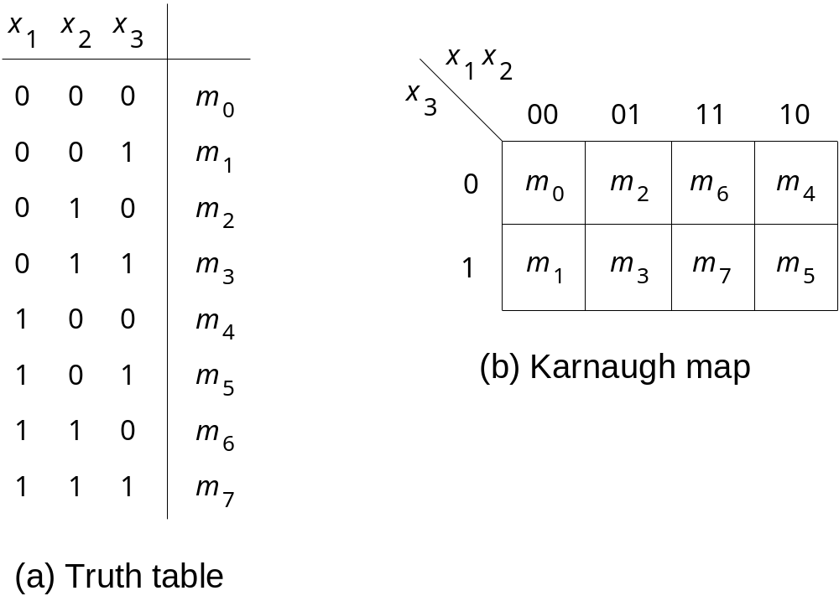
Two Different Ways to Draw the K-map
 | x₂x₃
x₁ |  | 00 | 01 | 11 | 10
 | 0 | m₀ | m₁ | m₃ | m₂
 | 1 | m₄ | m₅ | m₇ | m₆

Slide 34
Another Way to Draw 3-variable K-map
 | x₁
x₂x₃ |  | 0 | 1
 | 00 | m₀ | m₄
 | 01 | m₁ | m₅
 | 11 | m₃ | m₇
 | 10 | m₂ | m₆

Slide 35
Gray Code
Sequence of binary codes
Consecutive lines vary by only 1 bit
000
001
011
010
110
111
101
100
00
01
11
10

Slide 36
Gray Code & K-map
s x₁
x₂

Slide 37
Gray Code & K-map
s x₁
x₂
000
010
110
100
001
011
111
101

Slide 38
Gray Code & K-map
s x₁
x₂
000
010
110
100
001
011
111
101
These two neighbors
differ only in the LAST bit

Slide 39
Gray Code & K-map
s x₁
x₂
000
010
110
100
001
011
111
101
These two neighbors
differ only in the LAST bit

Slide 40
Gray Code & K-map
s x₁
x₂
000
010
110
100
001
011
111
101
These two neighbors
differ only in the FIRST bit

Slide 41
Gray Code & K-map
s x₁
x₂
000
010
110
100
001
011
111
101
These two neighbors
differ only in the FIRST bit

Slide 42
Adjacency Rules
s x₁
x₂
000
010
110
100
001
011
111
101
adjacent
columns

Slide 43
Gray Code & K-map
s x₁
x₂
000
010
110
100
001
011
111
101
These four neighbors
differ in the FIRST and LAST bit
They are similar in their MIDDLE bit

Slide 44
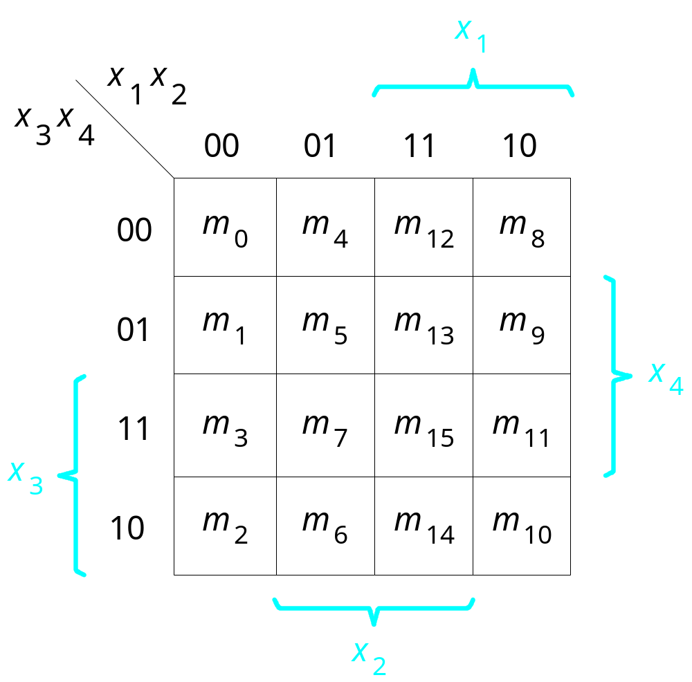
A four-variable Karnaugh map
[ Figure 2.53 from the textbook ]

Slide 45
A four-variable Karnaugh map
x1 | x2 | x3 | x4
0 | 0 | 0 | 0 | m0
0 | 0 | 0 | 1 | m1
0 | 0 | 1 | 0 | m2
0 | 0 | 1 | 1 | m3
0 | 1 | 0 | 0 | m4
0 | 1 | 0 | 1 | m5
0 | 1 | 1 | 0 | m6
0 | 1 | 1 | 1 | m7
1 | 0 | 0 | 0 | m8
1 | 0 | 0 | 1 | m9
1 | 0 | 1 | 0 | m10
1 | 0 | 1 | 1 | m11
1 | 1 | 0 | 0 | m12
1 | 1 | 0 | 1 | m13
1 | 1 | 1 | 0 | m14
1 | 1 | 1 | 1 | m15

Slide 46
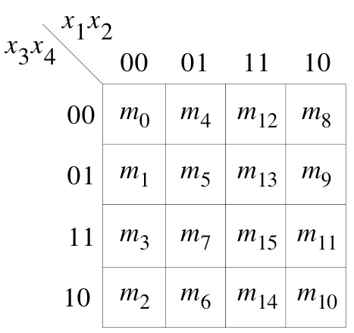

Adjacency Rules
adjacent
rows
adjacent
columns
adjacent
columns

Slide 47
Gray Code & K-map
x1 | x2 | x3 | x4
0 | 0 | 0 | 0 | m0
0 | 0 | 0 | 1 | m1
0 | 0 | 1 | 0 | m2
0 | 0 | 1 | 1 | m3
0 | 1 | 0 | 0 | m4
0 | 1 | 0 | 1 | m5
0 | 1 | 1 | 0 | m6
0 | 1 | 1 | 1 | m7
1 | 0 | 0 | 0 | m8
1 | 0 | 0 | 1 | m9
1 | 0 | 1 | 0 | m10
1 | 0 | 1 | 1 | m11
1 | 1 | 0 | 0 | m12
1 | 1 | 0 | 1 | m13
1 | 1 | 1 | 0 | m14
1 | 1 | 1 | 1 | m15

Slide 48
Gray Code & K-map
x1 | x2 | x3 | x4
0 | 0 | 0 | 0 | m0
0 | 0 | 0 | 1 | m1
0 | 0 | 1 | 0 | m2
0 | 0 | 1 | 1 | m3
0 | 1 | 0 | 0 | m4
0 | 1 | 0 | 1 | m5
0 | 1 | 1 | 0 | m6
0 | 1 | 1 | 1 | m7
1 | 0 | 0 | 0 | m8
1 | 0 | 0 | 1 | m9
1 | 0 | 1 | 0 | m10
1 | 0 | 1 | 1 | m11
1 | 1 | 0 | 0 | m12
1 | 1 | 0 | 1 | m13
1 | 1 | 1 | 0 | m14
1 | 1 | 1 | 1 | m15
0000
0100
1100
1000
0001
0101
1101
1001
0011
0111
1111
1011
0010
0110
1110
1010

Slide 49
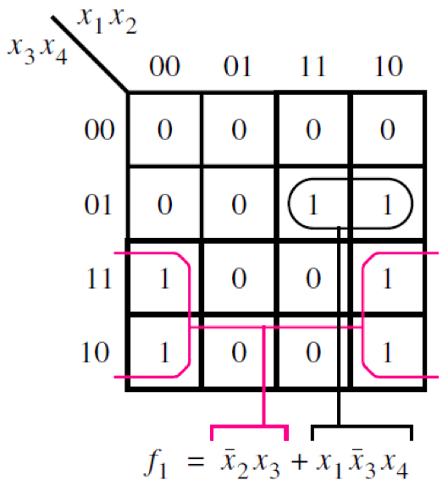
Example of a four-variable Karnaugh map
[ Figure 2.54 from the textbook ]

Slide 50
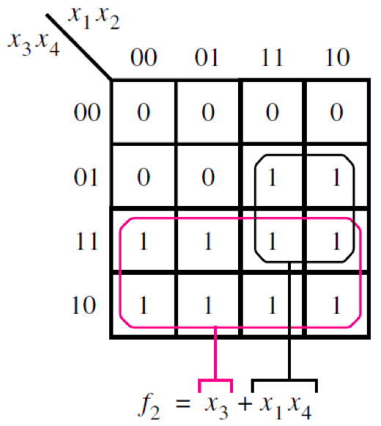
Example of a four-variable Karnaugh map
[ Figure 2.54 from the textbook ]

Slide 51
Strategy For Minimization

Slide 52
Grouping Rules
Group “1”s with rectangles
Both sides a power of 2:
  1x1, 1x2, 2x1, 2x2, 1x4, 4x1, 2x4, 4x2, 4x4
Can use the same minterm more than once
Can wrap around the edges of the map
Some rules in selecting groups:
  Try to use as few groups as possible to cover all “1”s.
  For each group, try to make it as large as you can (i.e., if you can use a 2x2, don’t use a 2x1 even if that is enough).

Slide 53
Terminology
  Literal: a variable, complemented or uncomplemented
  Some Examples:
  X₁
  X₂
_

Slide 54
Terminology
Implicant: product term that indicates the input combinations for which function output is 1
Example
  x₁ - indicates that x₁x₂ and x₁x₂ yield output of 1
_
_
_
_
x
1
x
2
0
1
0
1
0
1
1
0

Slide 55
Terminology
Prime Implicant
  Implicant that cannot be combined into another implicant with fewer literals
  Some Examples
x
1
x
2
x
1
x
2
x
3
x
3
00
01
11
10
00
01
11
10
0
0
1
1
1
0
0
1
1
1
1
1
1
1
0
1
1
1
1
0
Not prime
Prime

Slide 56
Terminology
Essential Prime Implicant
  Prime implicant that includes a minterm not covered by any other prime implicant
  Some Examples
x
1
x
2
x
3
00
01
11
10
0
0
1
1
1
1
1
1
0
0

Slide 57
Terminology
Cover
  Collection of implicants that account for all possible input valuations where output is 1
  Ex. x₁’x₂x₃ + x₁x₂x₃’ + x₁x₂’x₃’
  Ex. x₁’x₂x₃ + x₁x₃’
x
1
x
2
x
3
00
01
11
10
0
0
0
1
1
1
0
1
0
0

Slide 58
Example
Give the Number of
  Implicants?
  Prime Implicants?
  Essential Prime Implicants?
x
1
x
2
x
3
00
01
11
10
0
1
1
0
0
1
1
1
1
0

Slide 59
Why concerned with minimization?
Simplified function
Reduce the cost of the circuit
  Cost: Gates + Inputs
  Transistors

Slide 60
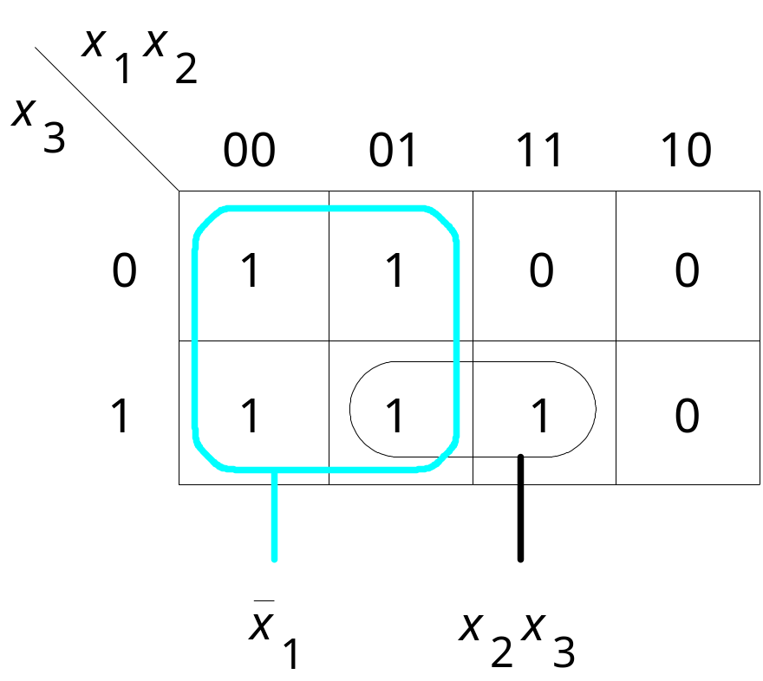
Three-variable function f (x₁, x₂, x₃) =  m(0, 1, 2, 3, 7)
[ Figure 2.56 from the textbook ]

Slide 61
Example
x
1
x
2
x
3
x
4
00
01
11
10
00
1
1
01
1
1
11
1
1
10
1
1

Slide 62
Example
x
1
x
2
x
3
x
4
00
01
11
10
00
1
1
01
1
1
11
1
1
10
1
1

Slide 63
Example
x
1
x
2
x
3
x
4
00
01
11
10
00
1
1
x
1
x
3
x
4
01
1
1
x
2
x
3
x
4
11
1
1
x
1
x
3
x
4
10
1
1
x
2
x
3
x
4

Slide 64
Example: Another Solution
x
1
x
2
x
3
x
4
00
01
11
10
00
1
1
x
1
x
3
x
4
01
1
1
x
2
x
3
x
4
11
1
1
x
1
x
3
x
4
10
1
1
x
2
x
3
x
4
x
1
x
2
x
4
x
1
x
2
x
4
x
1
x
2
x
3
x
1
x
2
x
3
[ Figure 2.59 from the textbook ]

Slide 65
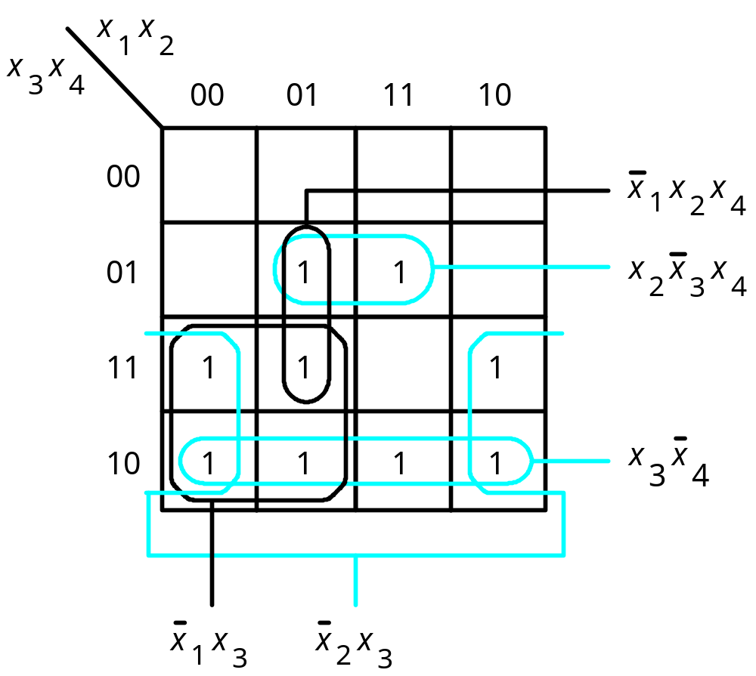
f ( x₁,…, x₄) =  m(2, 3, 5, 6, 7, 10, 11, 13, 14)
[ Figure 2.57 from the textbook ]

Slide 66
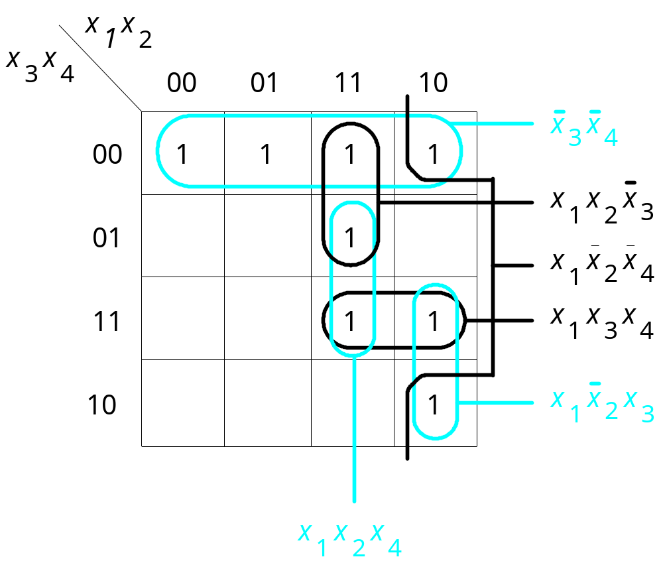
f ( x₁,…, x₄) =  m(0, 4, 8, 10, 11, 12, 13, 15)
[ Figure 2.58 from the textbook ]

Slide 67
Minimization of Product-of-Sums Forms

Slide 68
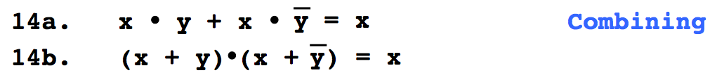
Do You Still Remember This
Boolean Algebra Theorem?

Slide 69
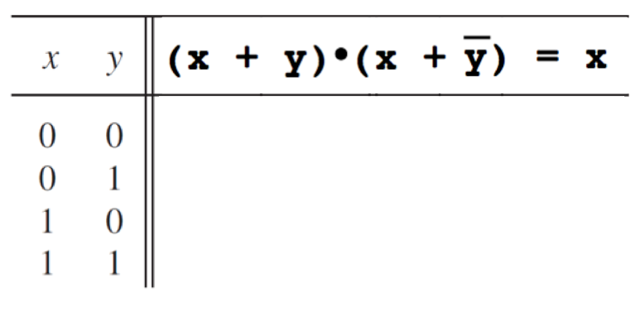
Let’s prove 14.b

Slide 70
Let’s prove 14.b
0
1
1
1

Slide 71
Let’s prove 14.b
0
1
1
0
1
1
1
1

Slide 72
Let’s prove 14.b
0
0
1
1
0
0
1
1
1
1
1
1

Slide 73
Let’s prove 14.b
0
0
1
0
1
0
0
0
1
1
1
1
1
1
1
1

Slide 74
Let’s prove 14.b
0
0
1
0
1
0
0
0
1
1
1
1
1
1
1
1
They are equal.

Slide 75
Grouping Example
x
1
x
1
x
2
x
2
0
1
0
1
0
0
1
0
1
0
1
1
1
1
1
1
M₀
M₂

Slide 76
Grouping Example
x
1
x
1
x
1
x
2
x
2
x
2
0
1
0
1
0
1
0
0
1
0
1
0
0
0
0
*
=
1
1
1
1
1
1
1
1
1
M₀
*
M₂
=
M₀ * M₂

Slide 77
Grouping Example
x
1
x
1
x
1
x
2
x
2
x
2
0
1
0
1
0
1
0
0
1
0
1
0
0
0
0
*
=
1
1
1
1
1
1
1
1
1
M₀
*
M₂
=
M₀ * M₂

Slide 78
Grouping Example
x
1
x
1
x
1
x
2
x
2
x
2
0
1
0
1
0
1
0
0
1
0
1
0
0
0
0
*
=
1
1
1
1
1
1
1
1
1
M₀
*
M₂
=
M₀ * M₂

Slide 79
Grouping Example
x
1
x
1
x
1
x
2
x
2
x
2
0
1
0
1
0
1
0
0
1
0
1
0
0
0
0
*
=
1
1
1
1
1
1
1
1
1
M₀
*
M₂
=
M₀ * M₂
_
( x₁ + x₂ )
*
( x₁+ x₂ )
=
x₂
Property 14b (Combining)

Slide 80
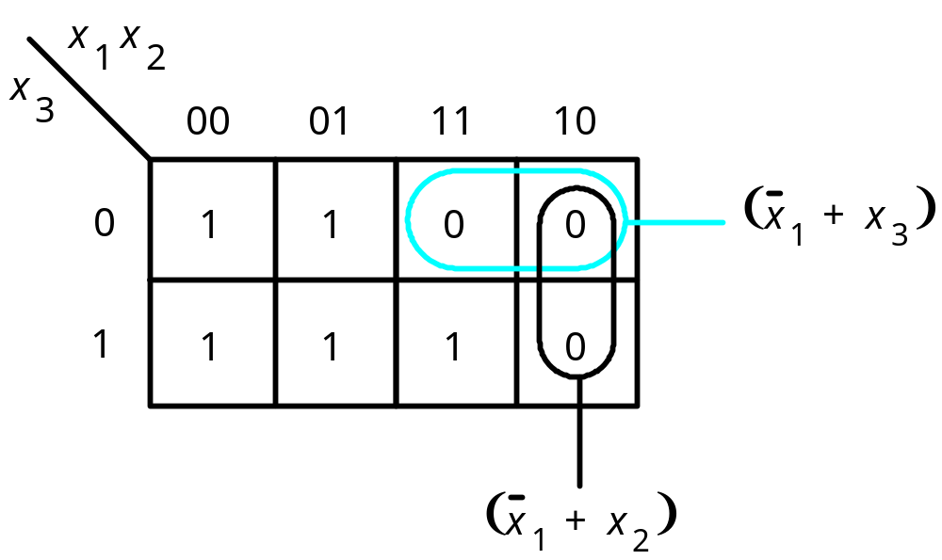
POS minimization of f (x₁, x₂, x₃) =  M(4, 5, 6)
[ Figure 2.60 from the textbook ]

Slide 81
POS minimization of f ( x₁,…, x₄) =  M(0, 1, 4, 8, 9, 12, 15)
x
x
x
x
1
2
3
4
00
01
11
10
(
)
00
0
0
0
0
x
+
x
3
4
01
0
1
1
0
(
)
x
+
x
2
3
11
1
1
0
1
10
1
1
1
1
(
)
x
+
x
+
x
+
x
1
2
3
4
[ Figure 2.61 from the textbook ]

Slide 82
Questions?

Slide 83
THE END

